Slide 1
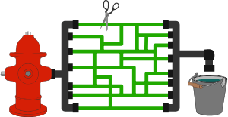
Network Flow
Ahmed Abd-Elsalam Muhammed Afify
Ali Abd-Elrahman Hegazy

Slide 2
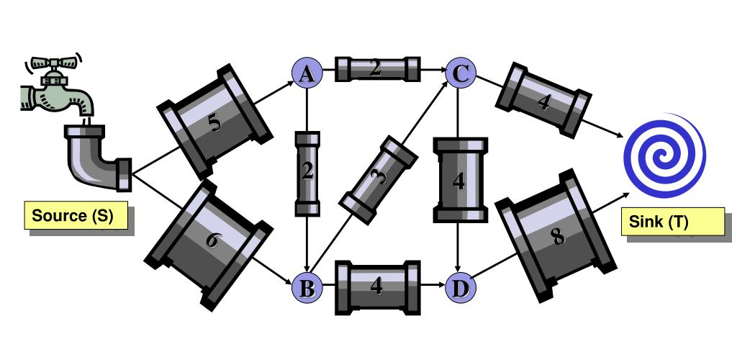
Agenda
Intro. And motivation.
Problem Definition.
Min-Cut.
Greedy Algorithm.
Residual Graph.
Augmentation Path.
Ford-Fulkerson Algorithm.
Algorithm Implementation.
Tracing Code.
Complexity and Big(O).
Max-Flow Min-Cut Theorem.
Analysis and Problems with Ford-Fulkerson Algorithm.
Real Life Applications.

Slide 3
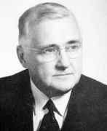
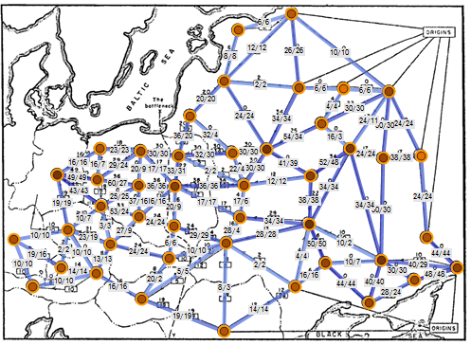
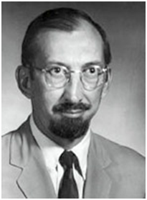
Intro. And Motivation:
In optimization theory, maximum flow problems involve finding a feasible flow through a flow network that obtains the maximum possible flow rate.
T. E. Harris and F. S. Ross (1954):
Simplifying the model of Soviet railway traffic flow.
Lester R. Ford, Jr. and Delbert R. Fulkerson (1955):
The first algorithm, the Ford–Fulkerson algorithm.

Slide 4
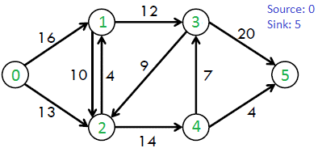
Flow Network Problem:
A directed graph G<V, E>.
Weights on edges denotes Capacities.
Two distinguished vertex:
S; source.
T; Target.
Rules:
Flow on an edge doesn’t exceed the given capacity of the edge.
Incoming flow is equal to outgoing flow for every vertex except s and t

Slide 5
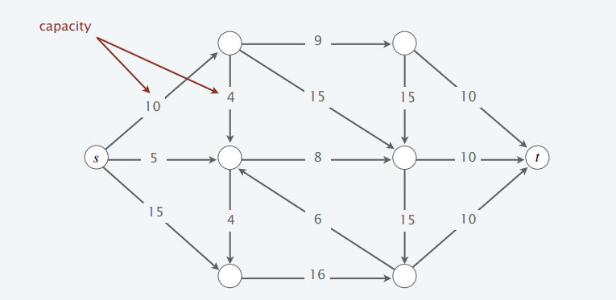
Max-Flow Min-Cut
states that in a flow network, the maximum amount of flow passing from the source to the sink is equal to the total weight of the edges in a minimum cut.
An st-cut (cut) is a partition (A, B) of the nodes with s ∈ A and t ∈ B.

Slide 6
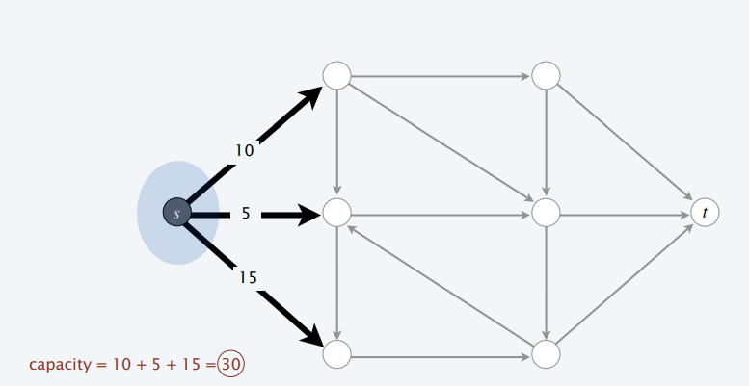
Max-Flow Min-Cut

Slide 7
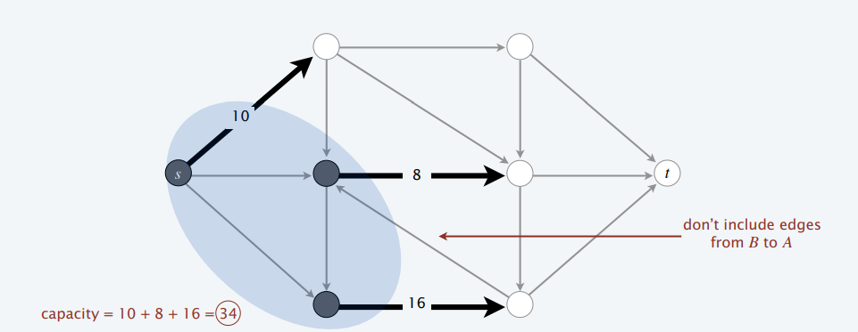
Max-Flow Min-Cut

Slide 8
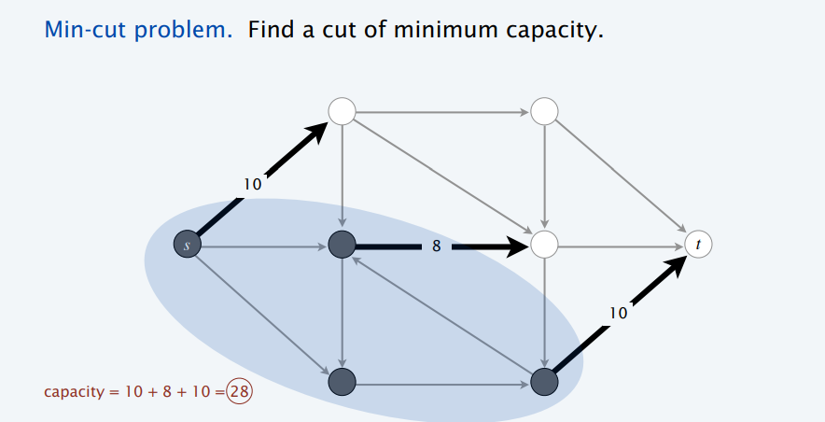
Max-Flow Min-Cut

Slide 9
Greedy Approach
Find The Max. flow path First and then find the second and so on.
Greedy algorithm:
Start with f (e) = 0
for each edge e ∈ E :
Find an s↝t path P where each edge has f (e) < c(e)
Augment flow along path P
Repeat until you get stuck

Slide 10
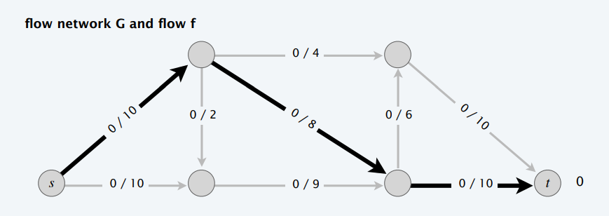
Greedy Approach

Slide 11
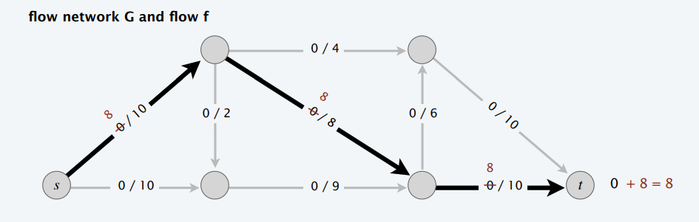
Greedy Approach

Slide 12
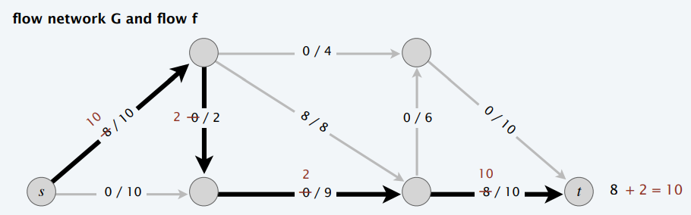
Greedy Approach

Slide 13
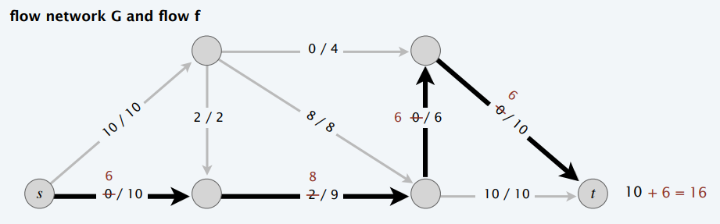
Greedy Approach

Slide 14
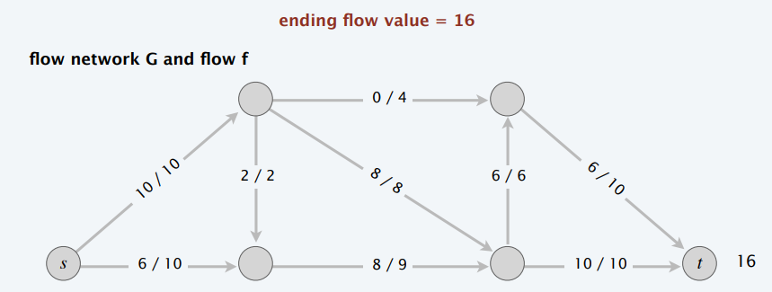
Greedy Approach

Slide 15
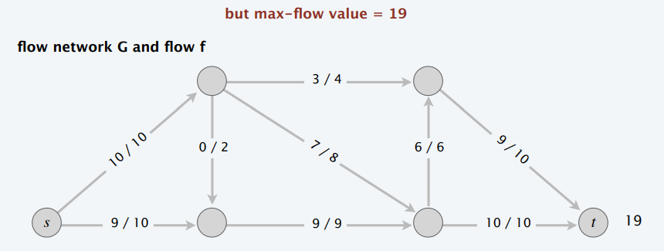
Greedy Approach

Slide 16
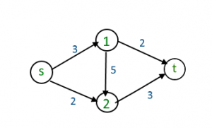
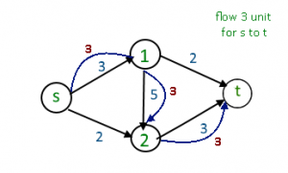
Greedy Approach
Another Example:

Slide 17
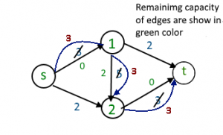
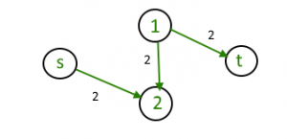
Greedy Approach

Slide 18
Greedy Approach
Why the greedy algorithm fails?
Once greedy algorithm increases flow on an edge, it never decreases it.
Problem: possible to get stuck at a flow that is not maximum, no more paths with excess capacity
So, we need some sort of algorithm or operations that allows us to find the optimal solution for this problem, and so came Ford and Fulkerson with the idea of Residual Graphs.

Slide 19

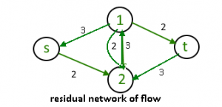
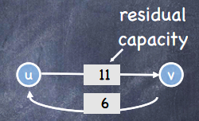
Residual graphs
The idea is to extend the naive greedy algorithm by allowing “Undo” operations.
we’d like to route two more units of flow along the edge (s, 2), then backward along the edge (1, 2), Undoing 2 of the 3 units we routed the previous iteration, and finally along the edge (1,t)
Backward edge: (f(e)) and forward edge: (C(e) – f(e))

Slide 20
Augmentation path
Definition : an s-t path P in Gf is an augmenting path
Idea : use an augmenting path to augment flow in G Increase flow on forward edges Decrease flow on backward edges .
Use path P in Gf to update flow f .
Claim : Let f be a flow and let f’ = Augment(f, P). Then f’ is a flow.
Proof Idea : verify capacity and conservation conditions.
1) Capacity: by design of residual graph.
2) Conservation: check that net change at each node is zero.

Slide 21
Augmentation path
UPDATING GRAPH AND CONSTUCTIN residual graph:
Augment(f, P) {
b = bottleneck(P, f) # edge on P with least residual capacity
Foreach e = (U, V) ∈ P {
if e is a forward edge
f(e) = f(e) + b # forward edge: increase flow
else
let e’ = (v, u)
f(e’) = f(e’) - b # backward edge: decrease flow
}
return f
}

Slide 22
Ford-Fulkerson Algorithm
The idea of residual graph is used The Ford-Fulkerson and Dinic’s algorithms.
Idea
Repeat: find an augmenting path, and augment!
Show Pseudocode.
Implement the Code In Jupyter Notebook.
Trace code.

Slide 23
Ford-Fulkerson Algorithm
PSEUDOCODE:
Ford-Fulkerson(G, s, t) {
foreach e ∈ E f(e) = 0 # initially, no flow
Gf = copy of G #residual graph = original graph
while (there exists an s-t path P in Gf) { # BFS or DFS
f = Augment(f, P) # change the flow
update Gf # build a new residual graph
}
return f
}

Slide 24
Ford-Fulkerson Algorithm
Implementation Notebook

Slide 25
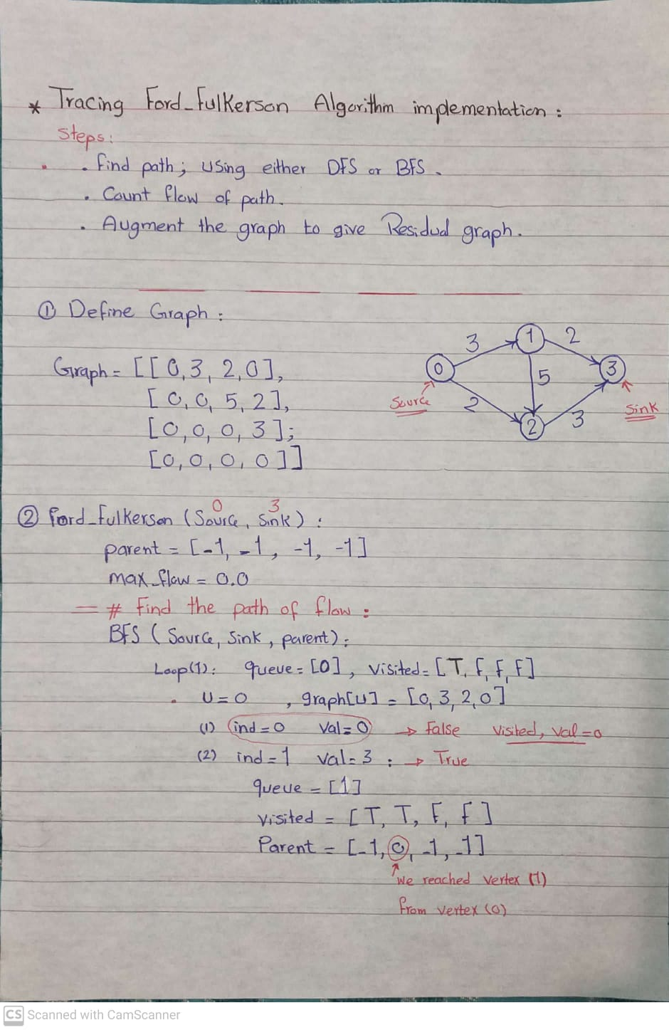
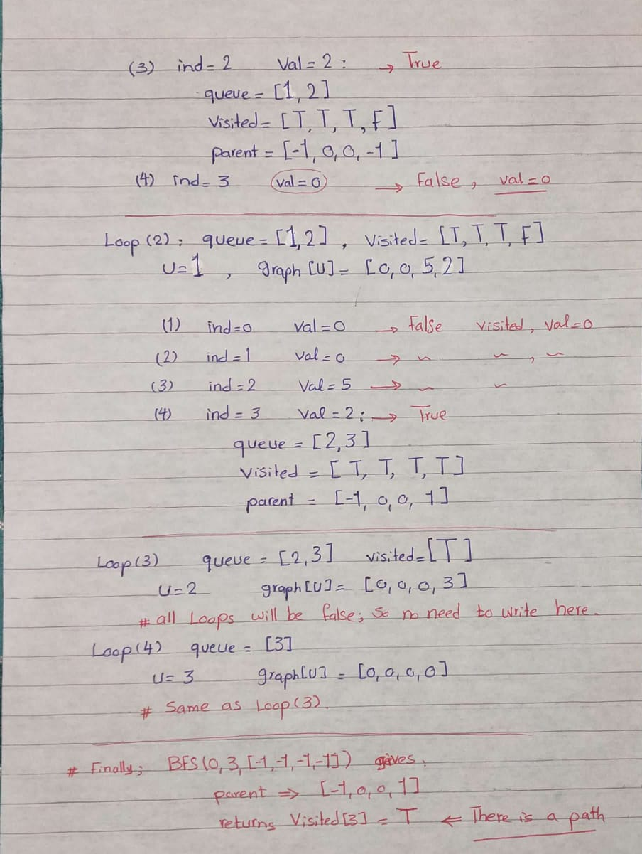
Ford-Fulkerson Tracing Code

Slide 26
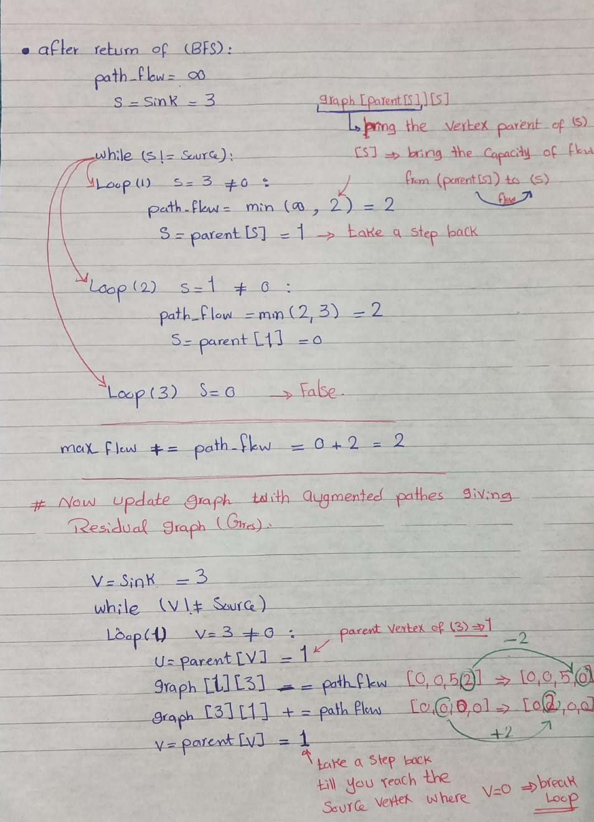
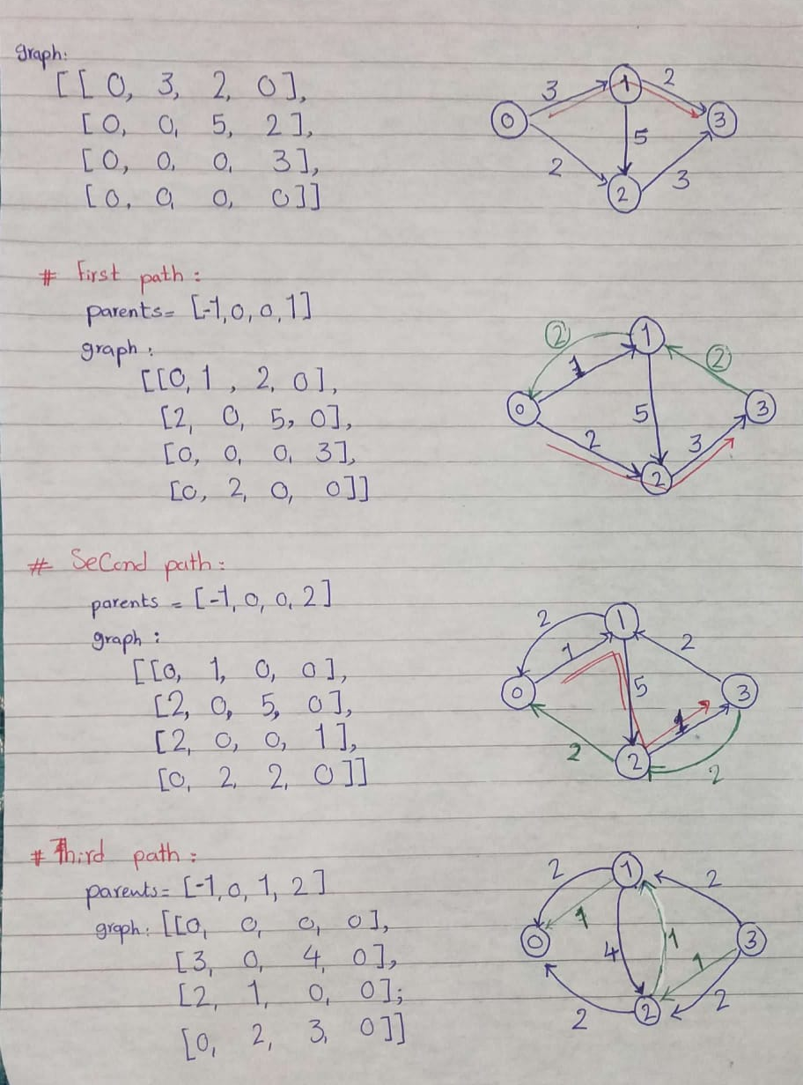
Ford-Fulkerson Tracing Code

Slide 27
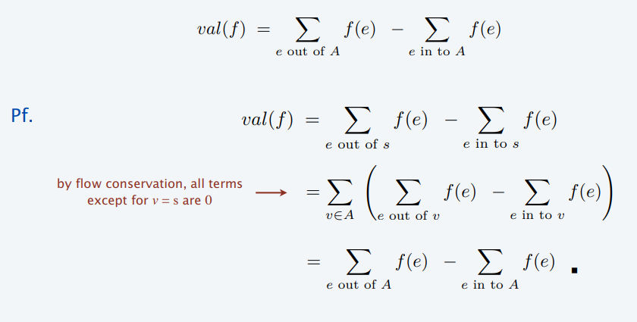
Max-Flow Min-Cut Theorem
Relationship between flows and cuts:
Flow value lemma. Let f be any flow, and let (A, B) be any s-t cut. Then, the net flow sent across the cut is equal to the amount leaving s

Slide 28
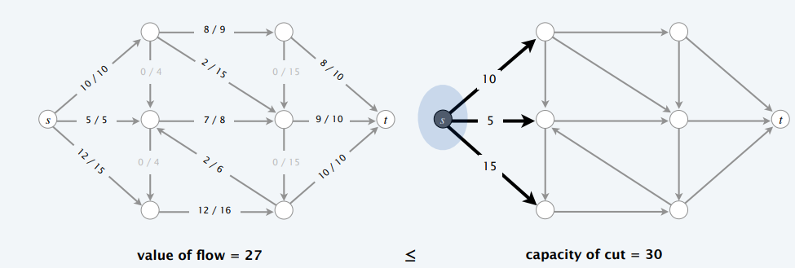
Max-Flow Min-Cut Theorem
Relationship between flows and cuts:
Weak duality Let f be any flow and (A, B) be any cut. Then, val(f) ≤ cap(A, B).

Slide 29
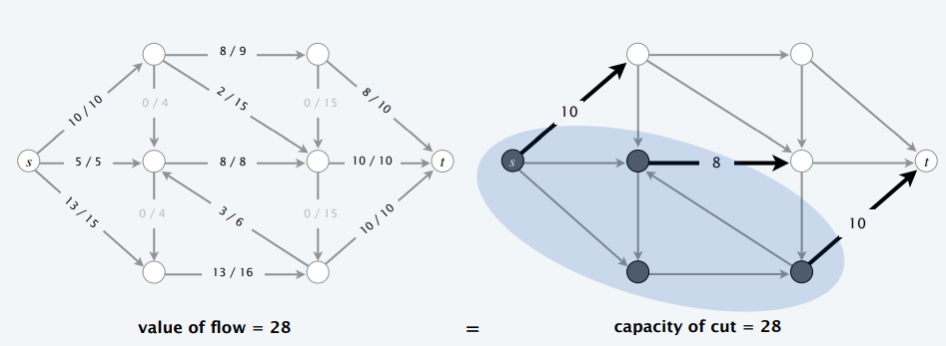
Max-Flow Min-Cut Theorem
Certificate of optimality:
Corollary: Let f be a flow and let (A, B) be any cut. If val(f) = cap(A, B), then f is a max flow and (A, B) is a min cut.

Slide 30
Max-Flow Min-Cut Theorem
Max-Flow Min-Cut Theorem:
states that:
Value of a max flow = capacity of a min cut.
Augmenting path theorem:
A flow f is a max flow if no augmenting paths.
The following three conditions are equivalent for any flow f :
There exists a cut (A, B) such that cap(A, B) = val(f).
f is a max flow.
There is no augmenting path with respect to f (if Ford–Fulkerson terminates, then f is max flow)

Slide 31
Analysis of Ford–Fulkerson algorithm
There are at most C augment operations. How long does it take for each?
Find a residual path O(m + n)
Compute bottleneck capacity O(m)
Update flow O(m)
Update residual graph O(m)
Total running time: O( C(m + n) )

Slide 32
Analysis of Ford–Fulkerson algorithm
Assumption: Every edge capacity c(e) is an integer between 1 and C.
Integrality invariant: Throughout Ford–Fulkerson, every edge flow f (e) and residual capacity cf (e) is an integer.
Prove → By induction on the number of augmenting paths
Theorem: Ford–Fulkerson terminates after at most val(f *) ≤ nC augmenting paths, where f * is a max flow.
Prove → Each augmentation increases the value of the flow by at least 1.
The running time of Ford–Fulkerson is O((m + n)C).
Prove → Can use either BFS or DFS to find an augmenting path in O(m) time.

Slide 33
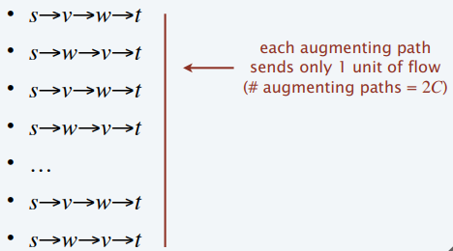
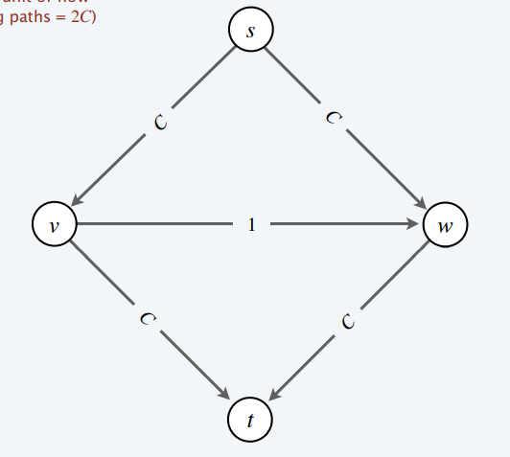
Analysis of Ford–Fulkerson algorithm
Is generic Ford–Fulkerson algorithm poly-time in input size (m, n, and log C)?
No. If max capacity is C, then algorithm can take ≥ C iterations.

Slide 34
Problems with Ford-Fulkerson Algorithm.
Choosing good augmenting paths:
Some choices lead to exponential algorithms.
Clever choices lead to polynomial algorithms.
When edge capacities can be irrational, no guarantee
that Ford–Fulkerson terminates (or converges to a maximum flow)!
Goal :Choose augmenting paths so that:
Can find augmenting paths efficiently.
Few iterations.

Slide 35

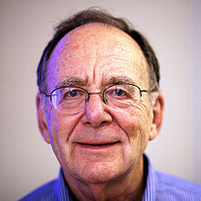

Problems with Ford-Fulkerson Algorithm.
Choose augmenting paths with:
Max bottleneck capacity (“fattest”).
Sufficiently large bottleneck capacity.
Fewest edges.
Another Improving Algorithms:
Dinitz` 1970 (Soviet Union) → O($V^{2}E)$
Edmonds-Karp 1972 (USA) → O(${VE}^{2})$

Slide 36
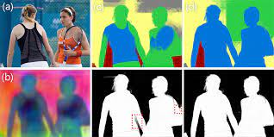
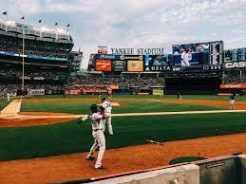
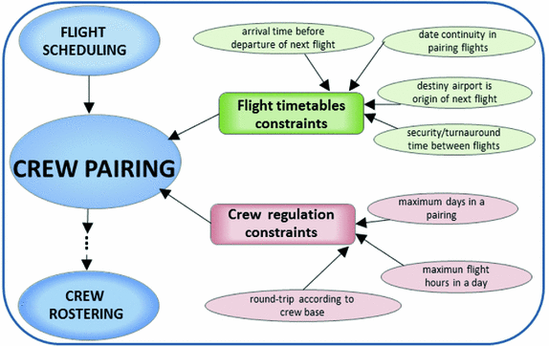
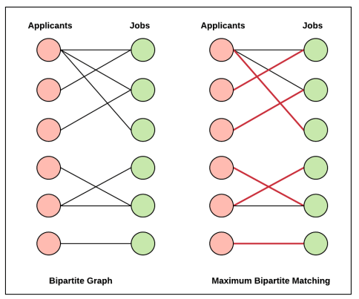
Real Life Applications.
Airline Scheduling.
Bipartite Matching.
Survey Design.
Image Segmentation.
Baseball Elimination Problem.

Slide 37


Slide 38
References:
https://www.youtube.com/watch?v=oHy3ddI9X3o&t=596s
https://en.wikipedia.org/wiki/Maximum_flow_problem
https://www.geeksforgeeks.org/ford-fulkerson-algorithm-for-maximum-flow-problem/
https://www.programiz.com/dsa/ford-fulkerson-algorithm
https://www.cs.princeton.edu/~wayne/kleinberg-tardos/pdf/07NetworkFlowI.pdf
https://people.cs.umass.edu/~sheldon/teaching/mhc/cs312/2013sp/Slides/Slides19%20-%20Ford-Fulkerson.pdf
https://www.cs.cmu.edu/~avrim/451f11/lectures/lect1025.pdf
http://theory.stanford.edu/~tim/w16/l/l1.pdf

